Slide 1


Robotic Arm BCI
309
8 Credits
11/02/2021
Robotic Arm BCI
‹#›

Slide 2

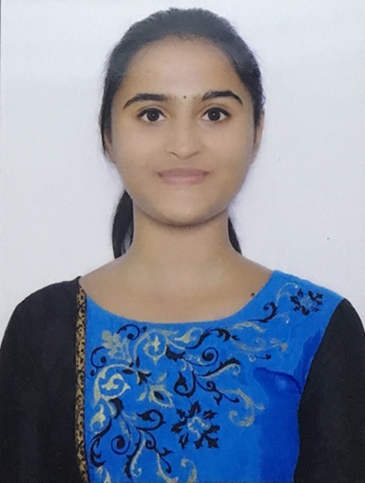
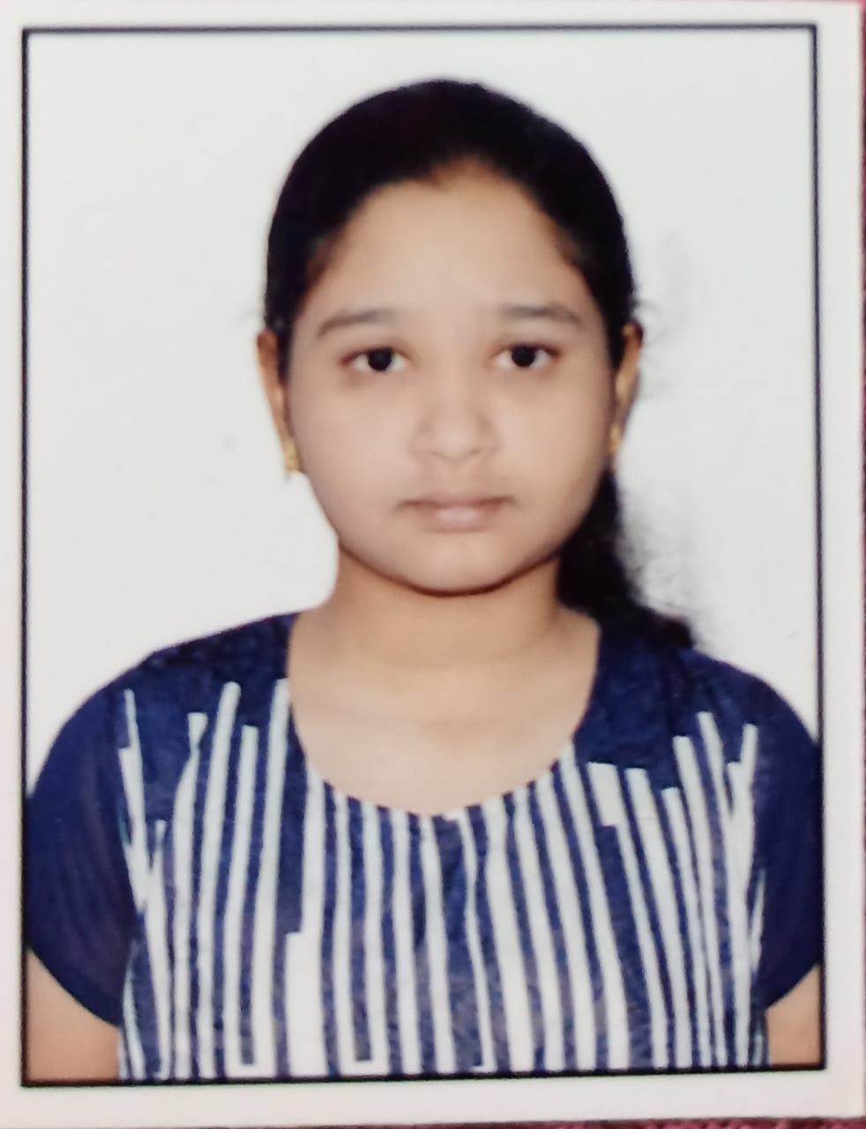
TEAM COMPOSITION
SL. NO | Name of the student | SRN | PHOTO
1 | Harshita R Vastrad | PES1201701717
2 | Shreya V Deexit | PES1201701648
3 | V Saisri | PES1201701763
Guide : Dr. B. Niranjana Krupa
Prof. Swetha G
11/02/2021
Robotic Arm BCI
‹#›

Slide 3
CONTENTS
SERIAL NO | CONTENT
1 | Problem Statement
2 | Work done in Phase-1
3 | Work done so far
4 | Next Step
5 | Timeline
6 | References
11/02/2021
Robotic Arm BCI
‹#›

Slide 4
PROBLEM STATEMENT
With the popularity of robots, how could the robot help the disabled suffering from neuromuscular injuries has attracted more and more attentions.
The objective here is to use Brain computer interface(BCI) to interact between robot and human, without participation of human hand and assist the patient impaired by neurological conditions
The robotic arm will be able to pick up lightweight objects from one place and drop it as interpreted from the brain waves of the user.
11/02/2021
Robotic Arm BCI
‹#›

Slide 5
Work done in Phase - 1
BCI Competition 2008 – Graz dataset A :
9 participants . 4 classes. Left hand,Right hand, Feet, Tongue.
22 EEG signals, 3 EOG signals(for eye movements)
Signals were sampled at 250Hz, and bandpass 0.5Hz and 100Hz,The sensitivity of the amplifier was set to 100μV. An additional 50 Hz notch filter was enabled to suppress line noise.
Extracting the data
Find the events
Bandpass filter
Removing bad channels
Plotting desired epochs
Renaming the labels
10 fold cross validation
Model build
Wavelet packet decomposition
Metrics
11/02/2021
Robotic Arm BCI
‹#›

Slide 6
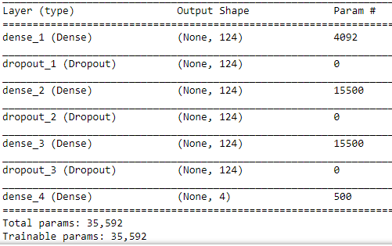
Work done in Phase - 1
Dropout : 0.5
L2 regularizer
Optimizer : Adam
2 Hidden Layers
loss = Categorical crossentropy
11/02/2021
Robotic Arm BCI
‹#›

Slide 7
Literature Survey
i) Rahul Kumar,Sunil Lal, Sanjesh Kumar, Praneel Chand,“Object detection and recognition for a pick and place Robot”, 05 March 2015,IEEE.
The image taken is resized to the dimensions of workspace
Via feature extraction algorithm, objects are detected, cropped and resized:The image is first converted to grayscale and then to binary and then finally edge detection criterion is applied to detect edges in a given image.
Then using the ANN classifier and 5-fold cross-validation, the object detected is classified and the coordinates of the corresponding object is determined
Accuracy of 82.7162% was obtained.
The scope of this paper is limited up-till here, however, from here-on is the task of the Robotic arm to pick the object from the location (coordinates) specified and place it according to the user's discretion.
11/02/2021
Robotic Arm BCI
‹#›

Slide 8
Literature Survey
ii)P.Hemalatha, C.K.Hemantha Lakshmi, Dr.S.A.K.Jilani,”Real time Image Processing based Robotic Arm Control Standalone System using Raspberry pi”,SSRG International Journal of Electronics and Communication Engineering (SSRG-IJECE) – Volume 2 Issue 8–August 2015
The Hardware requires Robot Arm, RPI Camera,Raspberrypi
Steps are as follows Capture the image,identify the object,apply BLOB analysis and find the centroid of the object,compare the co-ordinates of the object with the co-ordinates of the image taken,move robotic arm towards center of the image.
11/02/2021
Robotic Arm BCI
‹#›

Slide 9
Literature Survey
iii)Vinay Krishna Sharma , L.R.D. Murthy , KamalPreet Singh Saluja , Vimal Mollyn ,
Gourav Sharma and Pradipta Biswas ,“Eye Gaze Controlled Robotic Arm for Persons with SSMI”
We aimed to automate the eye tracking process electronically by using commercially available tablet, computer or laptop and without requiring any dedicated hardware for eye gaze tracking.
Constrained Local Neural Field (CLNF) for eye landmark detection and tracking.
The proposed setup consists of a robotic arm and a tablet computer.
Less accuracy
11/02/2021
Robotic Arm BCI
‹#›
Notes:
(PDF) Eye Gaze Controlled Robotic Arm for Persons with SSMI. Available from: https://www.researchgate.net/publication/341639835_Eye_Gaze_Controlled_Robotic_Arm_for_Persons_with_SSMI [accessed Feb 10 2021].

Slide 10
Objectives of Phase- II
Build the Robotic Arm:
-- The robotic arm mounted on a chassis which could move and fetch objects.
Image processing for recognition of objects to pick and drop:
-- This process involves object detection. The robot will be able to detect
Objects based on certain colour, pick and drop the detected object.
Performing tasks according to classified output:
-- Interfacing the classified output with the robotic arm and performing a particular task based on the input received.
11/02/2021
Robotic Arm BCI
‹#›
Notes:
(PDF) Eye Gaze Controlled Robotic Arm for Persons with SSMI. Available from: https://www.researchgate.net/publication/341639835_Eye_Gaze_Controlled_Robotic_Arm_for_Persons_with_SSMI [accessed Feb 10 2021].

Slide 11
WORK DONE
Assembling the components
The components used in the project are:
Raspberry Pi 3 B
DC motors
H-Bridge
Arm Clip
Chassis
Raspberry Pi Configuration
-- Installed Raspberry Pi OS onto the SD card.
-- Converted the Disk image file using Raspberry Pi Imager.
-- Installed Putty and VNC to access the Pi via SSH and VNC respectively.
11/02/2021
Robotic Arm BCI
‹#›

Slide 12
OBJECT DETECTION
Assumption
Objects - colored boxes
To Find
coordinates, width, height of colored object
Color Detection in Real-Time using Python-OpenCV
Python Libraries Used:
NumPy
OpenCV-Python
11/02/2021
Robotic Arm BCI
‹#›

Slide 13

WORKFLOW
Input: capture video through webcam
Get image frames from video stream
RGB color space transformed to HSV color space
Define range and create mask
Output: Object detection with co-ordinates
Collect information of object
Get max contour
deleting noise in area of mask
11/02/2021
Robotic Arm BCI
‹#›

Slide 14
Object Detection
Input: Capture video through webcam
Read the video stream in image frames.
Gaussian Blurring for decreasing the noises
Convert the imageFrame in BGR(RGB color space represented as three matrices of red, green and blue with integer values from 0 to 255) to HSV(hue-saturation-value) color space
Defining mask to detect blue object
Applying morphological Operations(Dilation, Erosion) to remove noises
Finding and getting biggest contour. Getting smallest rectangle to cover the area of the contour
Drawing center and contour and displaying object information.
.
11/02/2021
Robotic Arm BCI
‹#›

Slide 15
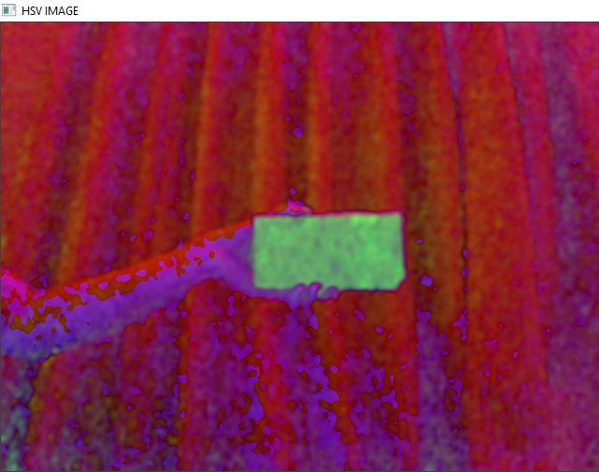
OUTPUT
HSV Image
After apply Gaussian Blurring for decreasing the noises and details in capture and converting RBG color space into HSV color space
11/02/2021
Robotic Arm BCI
‹#›

Slide 16
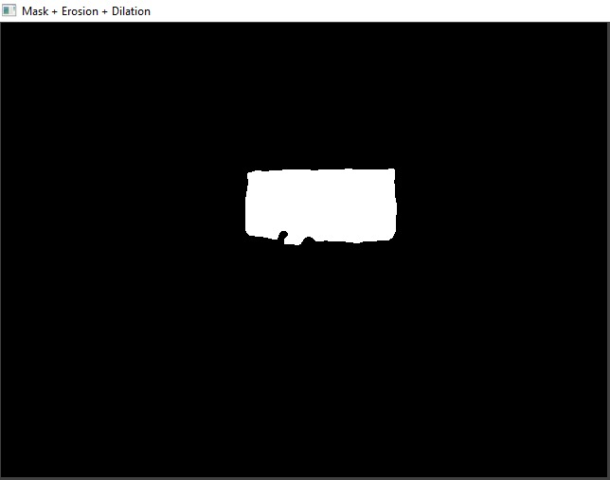
OUTPUT
After
Masking
For color blue
Eroding
Removes white noises
Shrinks object
Dilating
Increases object area
Image looks like this
Erosion followed by Dilation removes noise
11/02/2021
Robotic Arm BCI
‹#›

Slide 17
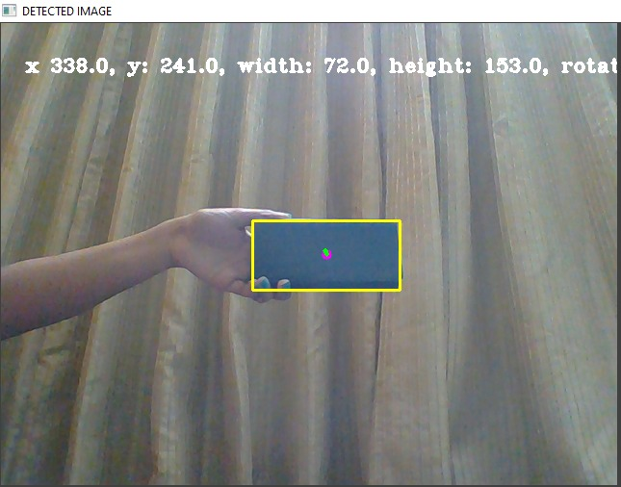
OUTPUT
Object Detected
Image shows contour and center of the object detected
11/02/2021
Robotic Arm BCI
‹#›

Slide 18
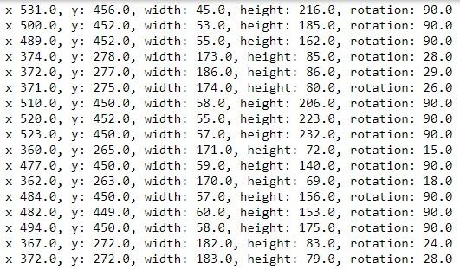
OUTPUT
Object information that is coordinates x and y, height, width and rotation
11/02/2021
Robotic Arm BCI
‹#›

Slide 19
NEXT STEP
Robotic Arm Movements
Pick and place object
Merging
11/02/2021
Robotic Arm BCI
‹#›

Slide 20
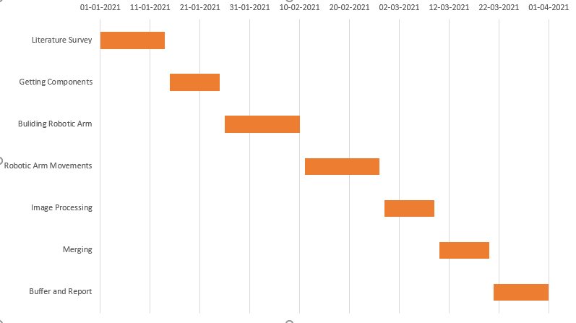
TIMELINE
11/02/2021
Robotic Arm BCI
‹#›

Slide 21
REFERENCES
Rahul Kumar,Sunil Lal, Sanjesh Kumar, Praneel Chand,“Object detection and recognition for a pick and place Robot”, 05 March 2015,IEEE.
P.Hemalatha, C.K.Hemantha Lakshmi, Dr.S.A.K.Jilani,”Real time Image Processing based Robotic Arm Control Standalone System using Raspberry pi”,SSRG International Journal of Electronics and Communication Engineering (SSRG-IJECE) – Volume 2 Issue 8–August 2015
Vinay Krishna Sharma , L.R.D. Murthy , KamalPreet Singh Saluja , Vimal Mollyn ,Gourav Sharma and Pradipta Biswas ,“Eye Gaze Controlled Robotic Arm for Persons with SSMI”
Initial Configuration of Pi https://projects.raspberrypi.org/en/projects/raspberry-pi-setting-up/1
Determining Object colour https://www.pyimagesearch.com/2016/02/15/determining-object-color-with-opencv/
11/02/2021
Robotic Arm BCI
‹#›

Slide 22
THANK YOU...
11/02/2021
Robotic Arm BCI
‹#›

